Slide 1
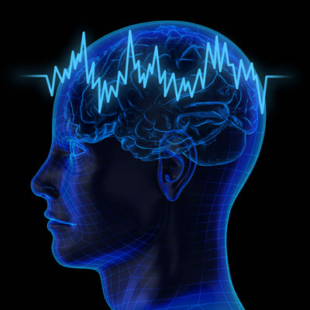
Computing with Rhythms: The search for Oscillatory Deep neural Networks
V. Srinivasa Chakravarthy
IIT Madras.
PhD Student
Dipayan Biswas

Slide 2
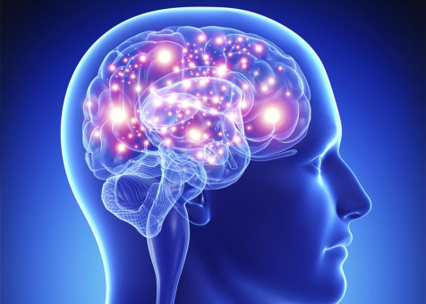
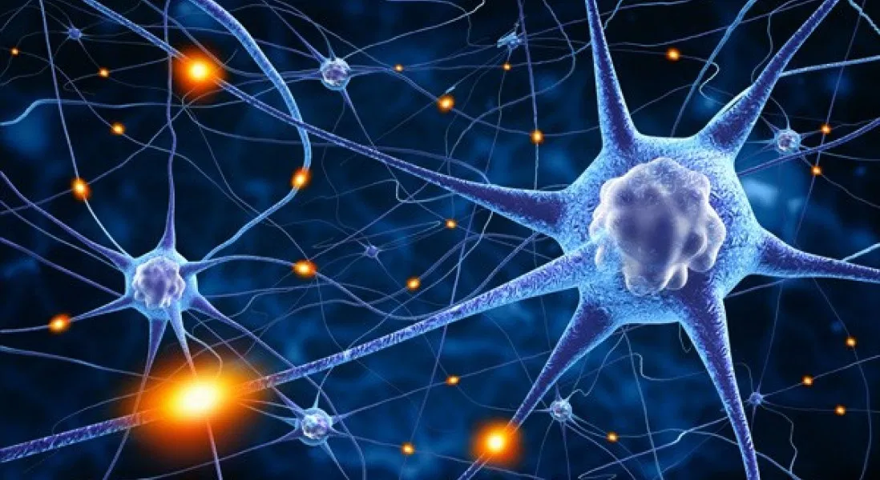
The Brain is a network of Neurons
Neurons communicate with each other by exchanging
electrical signals

Slide 3
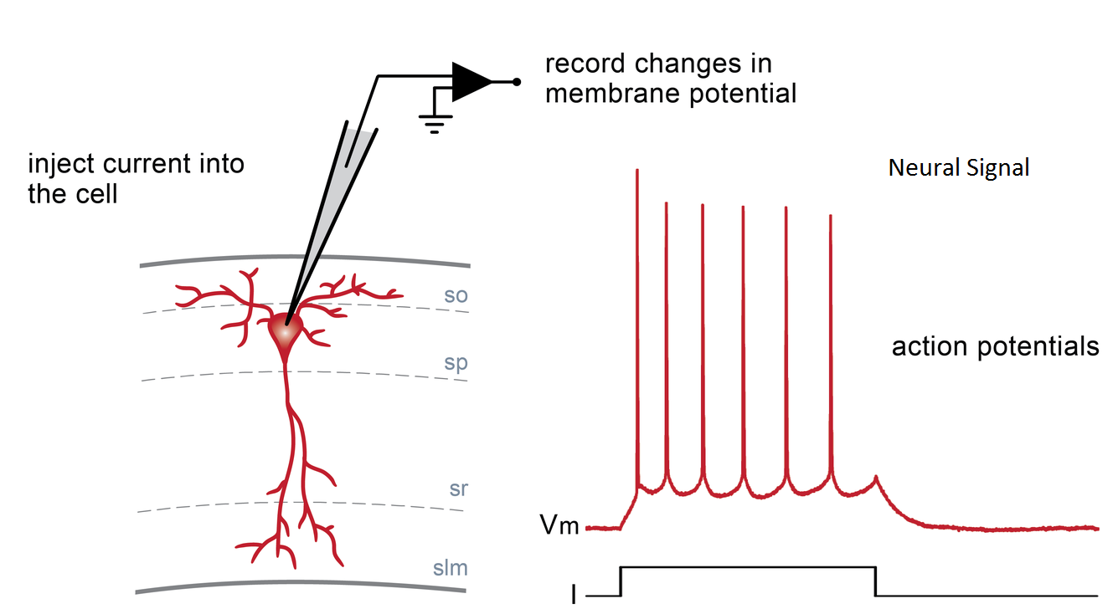

Slide 4
What is the neural code?
How do you mathematically describe the information present
in the electrical spiking activity of a neuron?

Slide 5
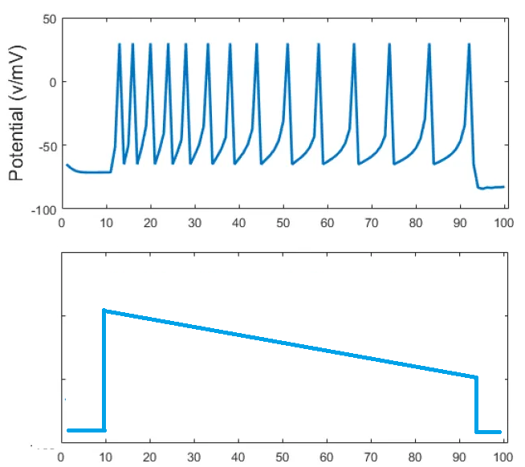
Two theories
Spike code
Rate Code
Information is present in the times of occurrence of the spikes
Information is present in the frequency (rate) of the spikes

Slide 6
Two Kinds of neural network models
Spiking neuron networks
Rate coded neural networks
Used often to model brain function
Used more in artificial, engineering domains
Eg. Deep neural networks

Slide 7
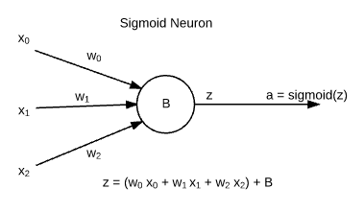
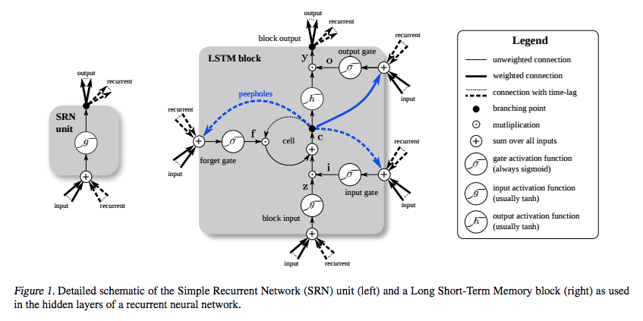
Rate-coded Neuron models
Sigmoidal neuron - static, rate-coded
Used in
Deep
Neural
Networks
Relu neuron - static, rate-coded
Long Short-Term Memory block:

Slide 8
Deep learning/ai
The aim of Deep learning/AI is to reproduce human intelligence.
The approach is to achieve it through an implementation of the human brain
Deep Neural networks are offered as an answer

Slide 9
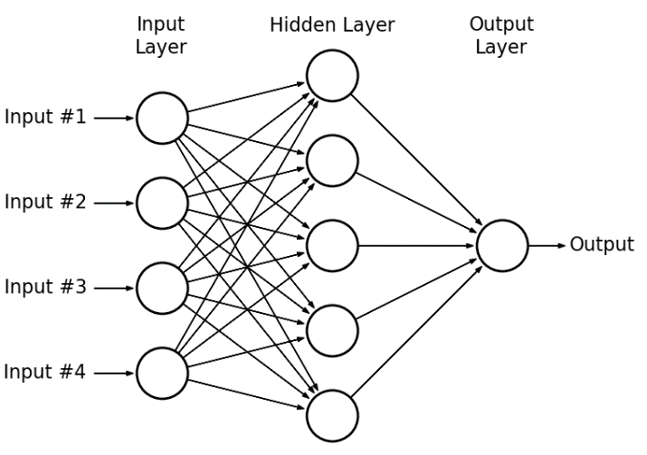
NNs and Deep NNs
1980s-1990s: Multilayer perceptrons and backpropagation
Deep learning – 2006
Powerful computational
properties.
Universal approximation
results
Multi-layer Perceptron

Slide 10
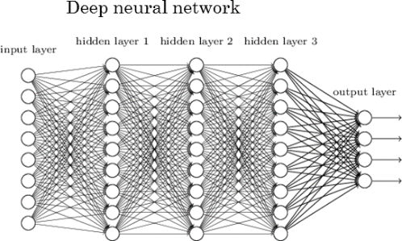
Deep Neural network
Has Universal Approximation properties
Can learn to map arbitrary input/output
Excellent applications in image pattern recognition,
Signal processing, robotics…

Slide 11
Spiking neuron models
Leaky Integrate and fire neuron (1 variable)
Izhikevich neuron (2 variables)
Hodgkin-Huxley neuron model (4 variables)
Biophysical neuron models (large number of variables)

Slide 12
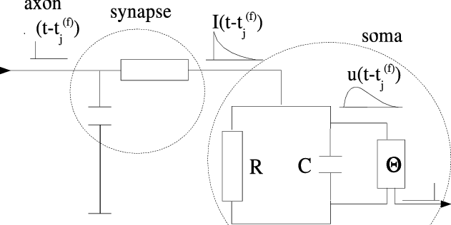
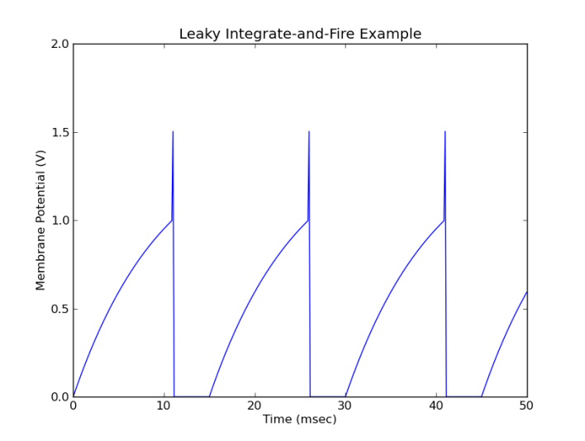
Leaky Integrate and fire Neuron model

Slide 13
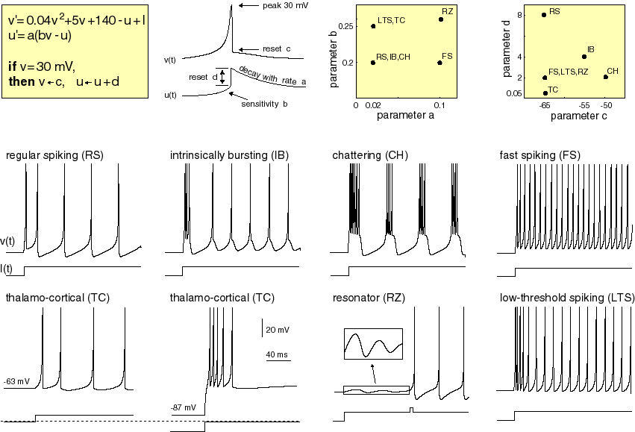
Izhikevich neuron model
https://www.izhikevich.org/publications/whichmod.htm

Slide 14
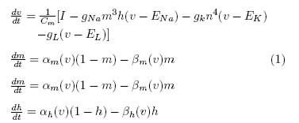
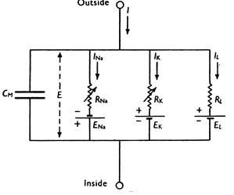
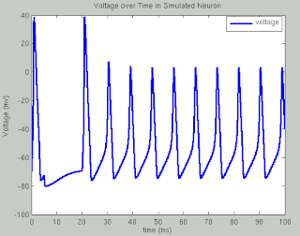
Hodgkin-Huxley neuron model
Hodgkin-Huxley Model (Example of a “point neuron” model)
Hodgkin & Huxley
Were awarded the
Nobel Prize in 1963

Slide 15
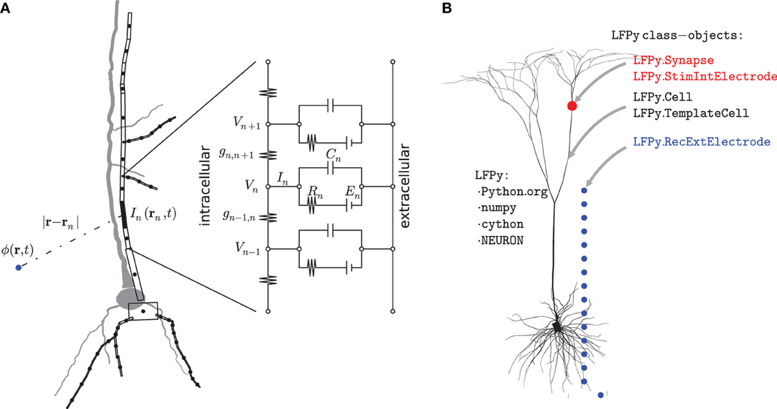
Biophysical neuron model
Simulate the entire neuronal arbor
https://www.frontiersin.org/articles/10.3389/fninf.2013.00041/full

Slide 16
Rate-coded
Neuron
Model
Detailed Spiking
Neuron
Model
- Sigmoid neuron
- LSTM etc
Conductance-based models (HH)
Biophysical models
Simplified spiking neuron models
TOO ARTIFICIAL
TOO REAL?
Is there a middle ground?

Slide 17
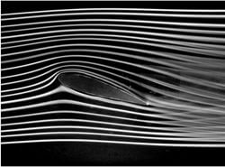
The question of the right Level
Example:
Aircraft wing in a wind tunnel
Study fluid flow using Navier Stokes Equation
FLUID is an abstraction
FLUID is NOT molecules

Slide 18
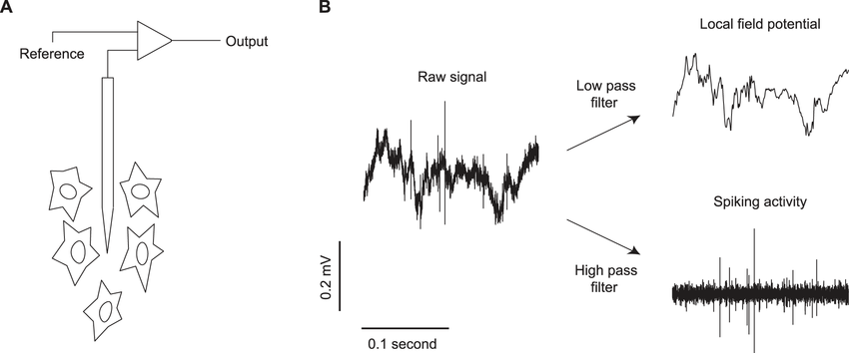
From Single Neuron to Neural Ensemble
Local field potential
activity of a local neural population
Neural field models:
Coarse-grained models of spatio-temporal evolution of neural tissue (eg cortex)

Slide 19
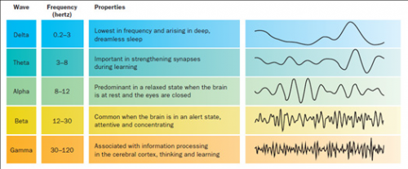
Neural "Waves”

Slide 20
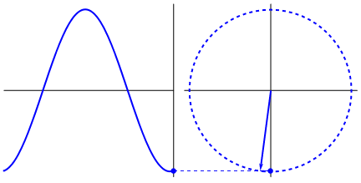
Do models of neural oscillators Occupy that ideal middle ground?
“Synchronous activity of oscillating networks is now viewed as the critical ‘middle ground’ linking single-neuron activity to behavior” - (Buzsaki and Draghun, Science 2004)

Slide 21
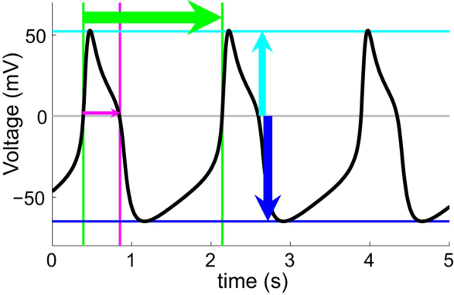
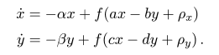
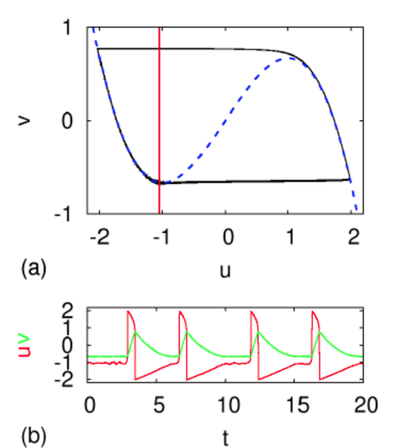
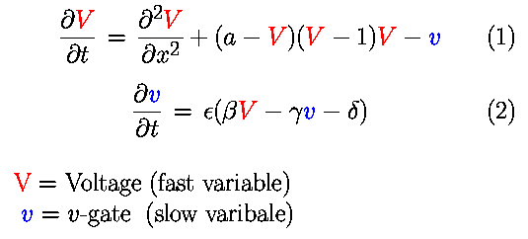
Neural Oscillator models (typically 2 variable models)
Wilson-Cowan model
FitzHugh - Nagumo model

Slide 22
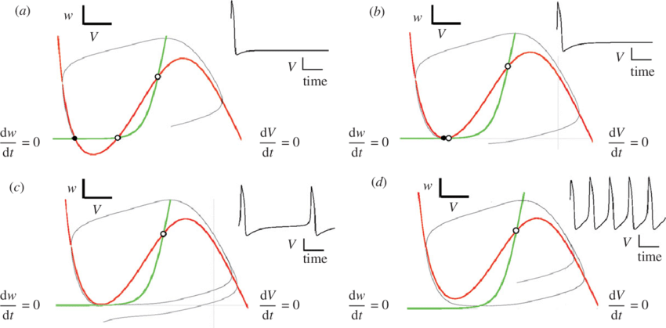
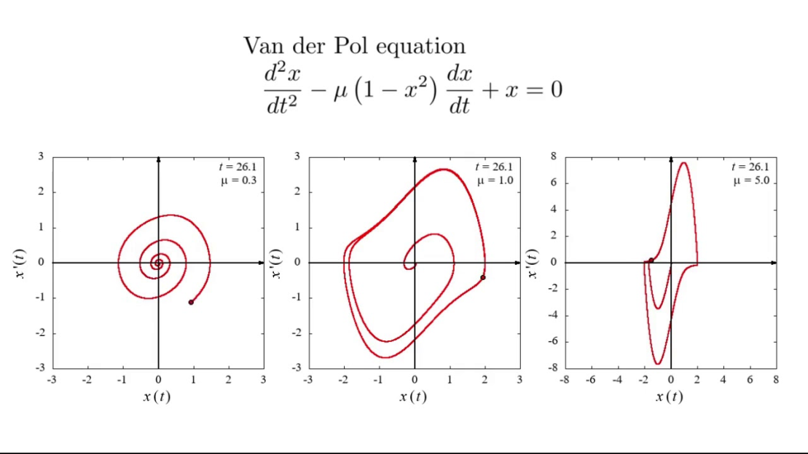
Morris-Lecarr model
Van Der Pol model

Slide 23
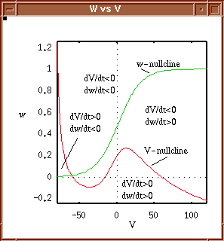
Phase Plane analysis
Two-variable form:
dx/dt = f(x,y)
dy/dt = g(x,y)
Can exhibit limit cycle oscillations

Slide 24
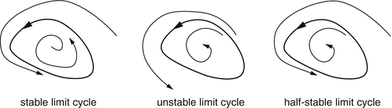
Limit Cycles
Definition: A limit cycle is a closed trajectory in phase space having the property that at least one other trajectory spirals into it either as time approaches infinity or as time approaches negative infinity.
Can only be exhibited by nonlinear systems.

Slide 25
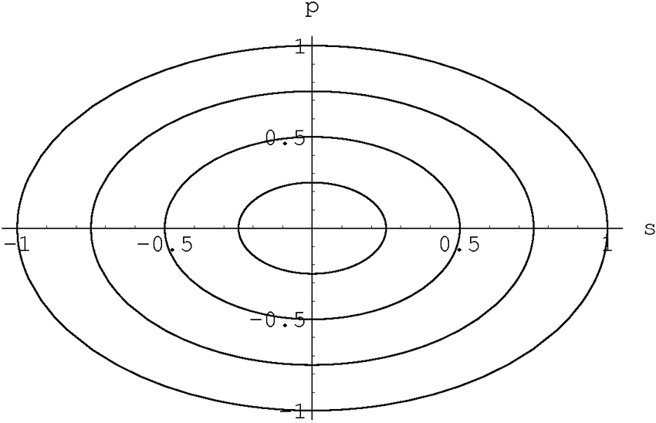
Harmonic oscillator
Two-variable form:
dx/dt = f(x,y) = wy
dy/dt = -wx
d²x/dt² = -w² x
Solution is strictly dependent on the initial condition
Neural oscillations are Limit Cycle type

Slide 26
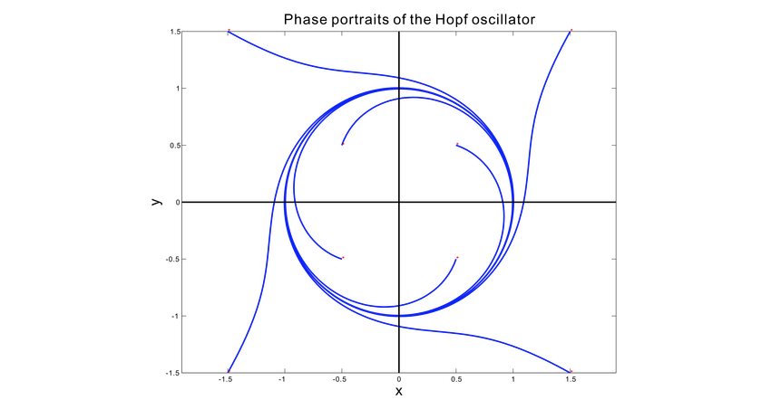
Hopf Oscillator
In polar coordinates the equations have an elegant form.
Let x= r cos(θ), y = r sin(θ)

Slide 28
Now consider,
Differentiating both sides,

Slide 29
In Complex variable form
Let
Equating real and
imaginary parts:

Slide 30
No nonlinearity → SHM
Eliminating nonlinearity…

Slide 31
RESEARCH Agenda
To construct general oscillatory neural networks using Hopf Oscillators:
Oscillatory Hopfield networks (done)
Oscillatory Auto Encoders (done)
Oscillatory Self-organizing Maps (SOMs)
Oscillatory Deep networks
Oscillatory Convolutional Networks etc etc

Slide 32
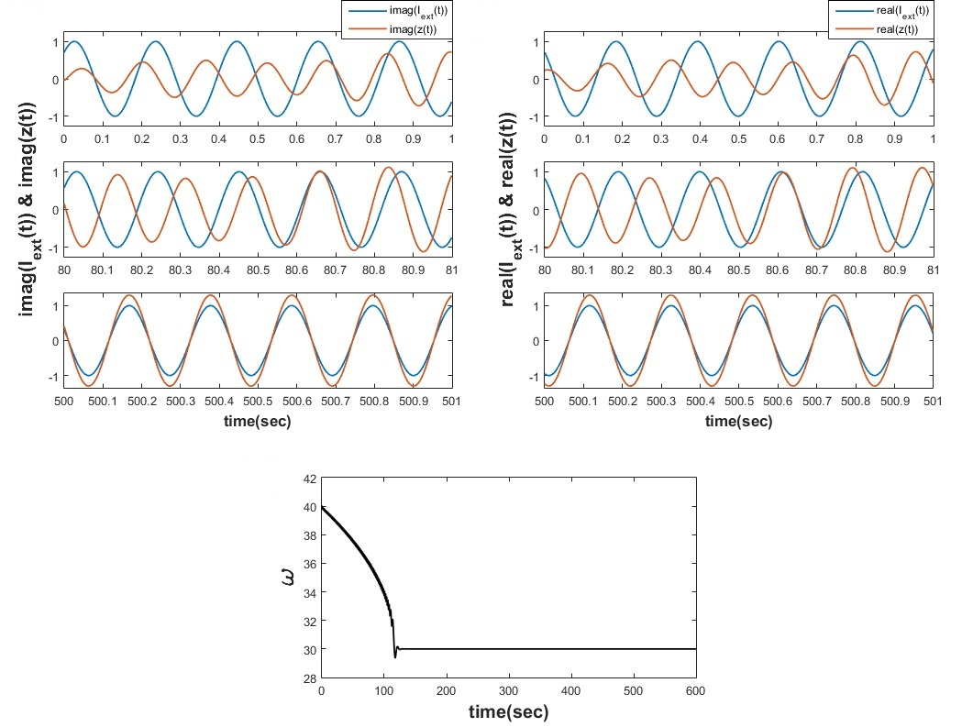
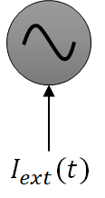
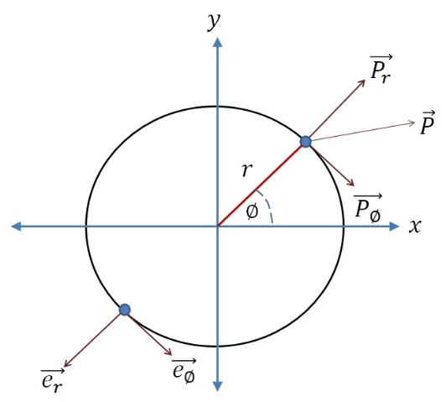


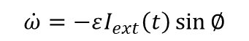
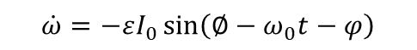
Complex Adaptive Hopf Oscillator:
$$\dot{z}=z\left(μ+iω−{\left|z\right|}^{2}\right)+εI_{ext}\left(t\right)$$
$$\dot{ω}=−εI_{ext}\left(t\right)\sin{∅}$$
$$I_{ext}\left(t\right)=I_{0}e^{i\left(ω_{0}t+φ\right)}$$
$$\dot{ω}=−ε\left(real\left(I_{ext}\left(t\right)\right)\sin{∅}−img\left(I_{ext}\left(t\right)\right)\cos{∅}\right)$$
$$\dot{ω}=−εI_{0}\sin\left(∅−ω_{0}t−φ\right)$$
Righetti et al., 2005
(Biswas & Chakravarthy, 2020)

Slide 34
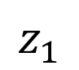
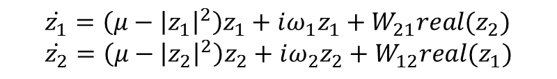
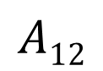
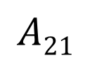
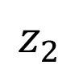
Problem#1 a PAIR OF COUPLED HOPF OSCILLATORS
$$\dot{z_{1}}=\left(μ−{\left|z_{1}\right|}^{2}\right)z_{1}+iω_{1}z_{1}+W_{21}real(z_{2}) \\ \dot{z_{2}}=\left(μ−{\left|z_{2}\right|}^{2}\right)z_{2}+iω_{2}z_{2}+W_{12}real(z_{1})$$
$$A12$$
What is the effect of
the Coupling Strength (A) on the Phase Difference (ψ)?
$$z_{1}$$
$$z_{2}$$
$$A21$$

Slide 35
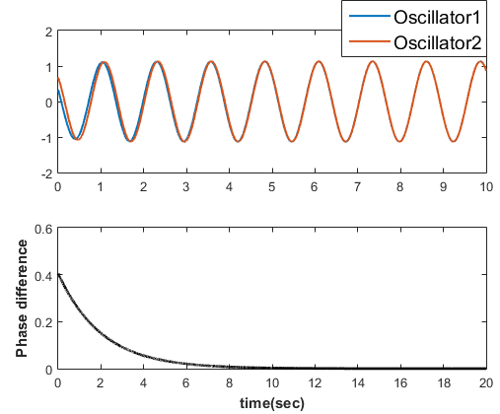
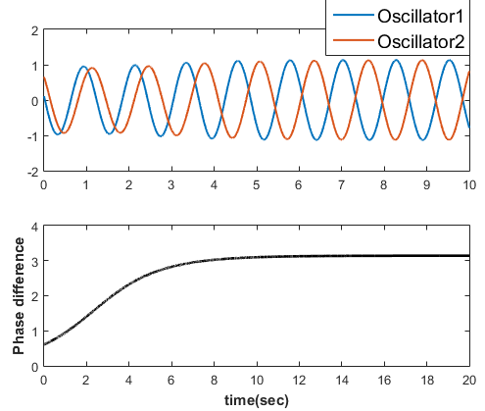


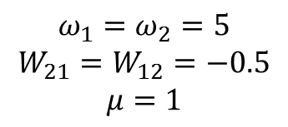
Two Hopf Oscillators SAME FREQUENCY ($ω_{1}=ω_{2}$), real coupling
$$ω_{1}=ω_{2}=5$$
$$W_{21}=W_{12}=0.5$$
$$μ=1$$
$$ω_{1}=ω_{2}=5$$
$$W_{21}=W_{12}=−0.5$$
$$μ=1$$

Slide 36
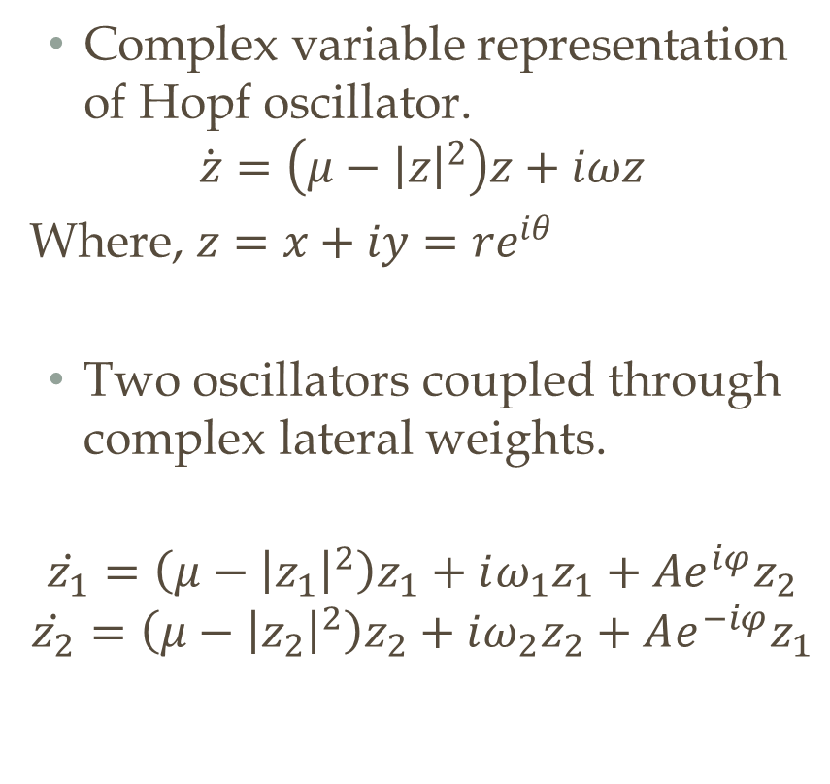
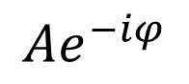

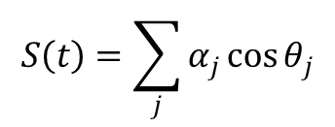
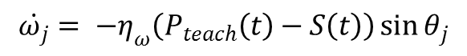
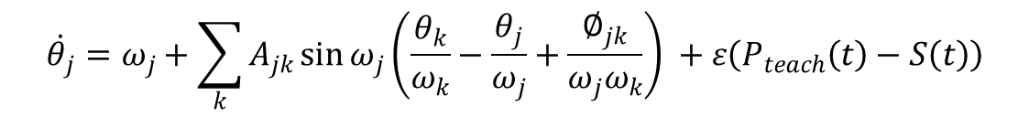
Two coupled Hopf oscillators: same frequencies ($ω_{1}=ω_{2}$), complex coupling
Complex variable representation of Hopf oscillator.
$$\dot{z}=\left(μ−{\left|z\right|}^{2}\right)z+iωz$$
Where, $z=x+iy=re^{iθ}$
Two oscillators coupled through complex lateral weights.
$$\dot{z_{1}}=\left(μ−{\left|z_{1}\right|}^{2}\right)z_{1}+iω_{1}z_{1}+Ae^{iφ}z_{2}$$
$$\dot{z_{2}}=\left(μ−{\left|z_{2}\right|}^{2}\right)z_{2}+iω_{2}z_{2}+Ae^{−iφ}z_{1}$$
$$Ae^{−iφ}$$
$$z_{1}$$
$$z_{2}$$
$$Ae^{iφ}$$

Slide 37
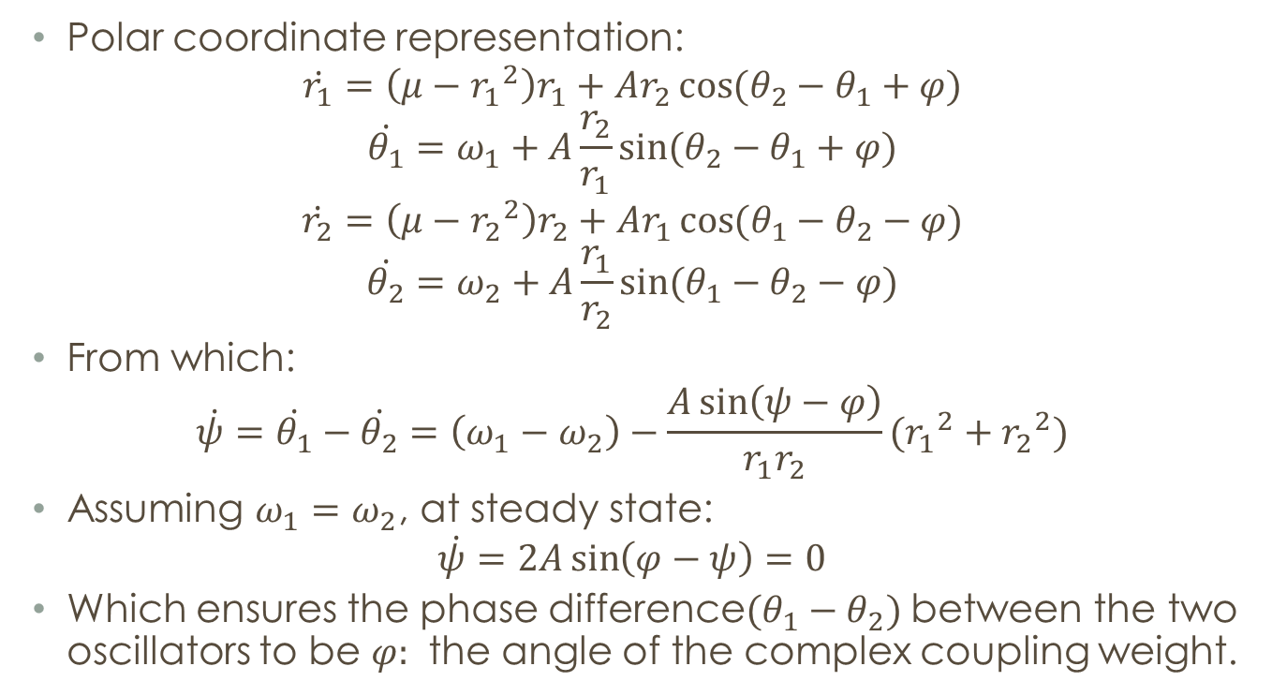
Theoretical explanation
Polar coordinate representation:
$$\dot{r_{1}}=\left(μ−{r_{1}}^{2}\right)r_{1}+Ar_{2}\cos{(θ_{2}−θ_{1}+φ)}$$
$$\dot{θ_{1}}=ω_{1}+A\frac{r_{2}}{r_{1}}\sin{(θ_{2}−θ_{1}+φ)}$$
$$\dot{r_{2}}=\left(μ−{r_{2}}^{2}\right)r_{2}+Ar_{1}\cos{(θ_{1}−θ_{2}−φ)}$$
$$\dot{θ_{2}}=ω_{2}+A\frac{r_{1}}{r_{2}}\sin{(θ_{1}−θ_{2}−φ)}$$
From which:
$$\dot{ψ}=\dot{θ_{1}}−\dot{θ_{2}}=\left(ω_{1}−ω_{2}\right)−\frac{A\sin\left(ψ−φ\right)}{r_{1}r_{2}}({r_{1}}^{2}+{r_{2}}^{2})$$
Assuming $ω_{1}=ω_{2}$, at steady state:
$$\dot{ψ}=2A\sin\left(φ−ψ\right)=0$$
Which ensures the phase difference$(θ_{1}−θ_{2})$ between the two oscillators to be $φ:$ the angle of the complex coupling weight.

Slide 39
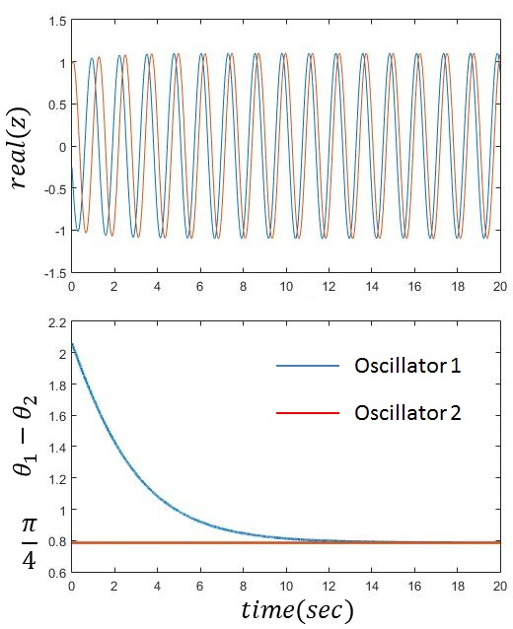

Numerical results
Parameters:
$$A=0.2, φ=\frac{π}{4}$$
$$ω_{1}=ω_{2}=5$$
Where: $z_{1}=r_{1}e^{iθ_{1}}$ and
$$z_{2}=r_{2}e^{iθ_{2}}$$

Slide 40

Coupling two Hopf oscillators NEARBY frequencies, real coupling
When two Hopf oscillators, with slightly different frequencies ($ω_{1}ω_{2}$ ) are coupled, for a sufficiently strong coupling strength, the two oscillators come to a common frequency ($ω$) such that ($ω_{1}<ω<ω_{2}$), with oscillator #2 leading oscillator #1.

Slide 41






$$\dot{z_{1}}=\left(μ−{\left|z_{1}\right|}^{2}\right)z_{1}+iω_{1}z_{1}+ε×real\left(z_{1}\right)$$
$$\dot{z_{2}}=\left(μ−{\left|z_{2}\right|}^{2}\right)z_{2}+iω_{2}z_{2}+ε×real\left(z_{2}\right)$$
Simulation parameters:
$$μ=1,ω_{1}=2,ω_{2}=2.2$$
$$ε$$
$$z_{1}$$
$$z_{2}$$
$$ε$$

Slide 42

Coupling two Hopf oscillators with arbitrarily different frequencies
When two oscillators with different intrinsic frequencies are coupled through real coupling weights a new behavior emerges while analyzing their synchronization behavior, called Arnold Tongues.
$$\dot{z_{1}}=\left(μ−{\left|z_{1}\right|}^{2}\right)z_{1}+iω_{1}z_{1}+ε×real\left(z_{1}\right)$$
$$\dot{z_{2}}=\left(μ−{\left|z_{2}\right|}^{2}\right)z_{2}+iω_{2}z_{2}+ε×real\left(z_{2}\right)$$

Slide 43

Coupling two Hopf oscillators: arbitrarily different frequencies , real coupling General scenario
ARNOLD TONGUES

Slide 44

Normalized phase difference
When the frequencies are different, the usual phase difference cannot be constant
But normalized phase difference can be constant
normalized phase difference:
$$ψ=\frac{θ_{1}}{ω_{1}}−\frac{θ_{2}}{ω_{2}}$$
This is what is constant when two oscillators are entrained in a simple integral ratio

Slide 45
How to achieve constant normalized phase difference for arbitrary frequencies?
Answer:
It requires a trick called
Power coupling

Slide 46

Transforming Transmitter frequencies to receiver frequency

Slide 47

How to transform ω₁ to ω₂?

Slide 48

Power coupling
Frequency of oscillator 1 is transformed into frequency of oscillator 2, as the signal passes over the connection

Slide 49

Theoretical ANALYSIS
Two oscillators coupled through “power coupling”:
$$\dot{z_{1}}=\left(μ−{\left|z_{1}\right|}^{2}\right)z_{1}+iω_{1}z_{1}+Ae^{i\frac{φ}{ω_{2}}}{z_{2}}^{\frac{ω_{1}}{ω_{2}}}$$
$$\dot{z_{2}}=\left(μ−{\left|z_{2}\right|}^{2}\right)z_{2}+iω_{2}z_{2}+Ae^{−i\frac{φ}{ω_{1}}}{z_{1}}^{\frac{ω_{2}}{ω_{1}}}$$
The angular part of the polar form:
$$\dot{θ_{1}}=ω_{1}+A\frac{{r_{2}}^{\frac{ω_{1}}{ω_{2}}}}{r_{1}}\sin{ω_{1}\left(\frac{θ_{2}}{ω_{2}}−\frac{θ_{1}}{ω_{1}}+\frac{φ}{ω_{1}ω_{2}}\right)}$$
$$\dot{θ_{2}}=ω_{2}+A\frac{{r_{1}}^{\frac{ω_{2}}{ω_{1}}}}{r_{2}}\sin{ω_{2}\left(\frac{θ_{1}}{ω_{1}}−\frac{θ_{2}}{ω_{2}}−\frac{φ}{ω_{1}ω_{2}}\right)}$$
We denote the normalized phase difference:
$$ψ=\frac{θ_{1}}{ω_{1}}−\frac{θ_{2}}{ω_{2}}$$

Slide 50

The derivative of normalized phase difference w.r.t time:
$$\dot{ψ}=\frac{\dot{θ_{1}}}{ω_{1}}−\frac{\dot{θ_{2}}}{ω_{2}}$$
$$\dot{ψ}=\frac{A{r_{2}}^{\frac{ω_{1}}{ω_{2}}}}{ω_{1}r_{1}}\sin{ω_{1}\left(\frac{φ}{ω_{1}ω_{2}}−ψ\right)}+\frac{A{r_{1}}^{\frac{ω_{2}}{ω_{1}}}}{{ω_{2}r}_{2}}\sin{ω_{2}\left(\frac{φ}{ω_{1}ω_{2}}−ψ\right)}$$
At steady state; $ψ=constant, \dot{ψ}=0$ and $r_{1}=r_{2}=1$:
$$\dot{ψ}=\frac{A}{ω_{1}}\sin{ω_{1}\left(\frac{φ}{ω_{1}ω_{2}}−ψ\right)}+\frac{A}{ω_{2}}\sin{ω_{2}\left(\frac{φ}{ω_{1}ω_{2}}−ψ\right)}=0$$
The steady state normalized phase difference satisfies the equation:
$$ψ=\frac{θ_{1}}{ω_{1}}−\frac{θ_{2}}{ω_{2}}=\frac{φ}{ω_{1}ω_{2}}$$

Slide 51



The $σ=\frac{θ_{1}\left(t\right)}{ω_{1}}−\frac{θ_{2}\left(t\right)}{ω_{2}}−\frac{φ}{ω_{1}ω_{2}}$ , $ψ\left(t\right)$ and $\dot{ψ}\left(t\right)$ variation w.r.t time for two ‘power coupled’ Hopf oscillators with the following parameters.
$ω_{1}=5$, $ω_{2}=10$, $A_{12}=A_{21}=0.2$, $φ=2.9644$. ϕ/50=ψ

Slide 52



Depending on initial values of $θ_{1}$ and $θ_{2}$, $σ_{ss}$ can attain any of the solutions of $\dot{ψ_{ss}}=0$ equation.
The solutions other than $σ_{ss}=0$ are: $σ_{ss}=\frac{2πn_{1}}{ω_{1}}=\frac{2πn_{2}}{ω_{2}}$, where $\frac{n_{1}}{n_{2}}=\frac{ω_{1}}{ω_{2}}$
In the simulated scenario the stable solutions are: $σ_{ss}=0, \frac{2n_{1}π}{ω_{1}}$=$\frac{2n_{2}π}{ω_{2}}$

Slide 53

Biological Interpretation

Slide 54








Frequency tracking
The intrinsic frequency of the oscillator can track the input frequency
$$\dot{x}=\left(1−r^{2}\right)x−ωy+εF\left(t\right)$$
$$\dot{y}=\left(1−r^{2}\right)y+ωx$$
$$\dot{ω}=−εF\left(t\right)\frac{y}{r}$$
$$x\left(t\right)$$
(Righetti et al 2005)
$$ω_{0}$$
Before Training
$$F\left(t\right)=Ae^{i(ωt)}$$
$$ω_{0}$$
$$ω_{}$$
After Training
$$ω_{0}$$
$$ω_{}$$

Slide 55








$$\dot{x}=\left(1−r^{2}\right)x−ωy+εF\left(t\right)$$
$$\dot{y}=\left(1−r^{2}\right)y+ωx$$
$$\dot{ω}=−εF\left(t\right)\frac{y}{r}$$
$ω\left(0\right)=40, ε=0.9$, $F\left(t\right)=\sin{30t}$
$$x\left(t\right)$$
$$F\left(t\right)$$

Slide 56

Coupled n-oscillator network
Reconstructing a time series
By taking a weighted sum of outputs
of N-oscillator network

Slide 57


Reconstructing a Time series
Network of n no of Kuramoto oscillators can learn Some sort of Fourier decomposition of any $P_{teach}\left(t\right)$ signal.
$$\dot{Z_{i}}=\left(μ−{\left|Z_{i}\right|}^{2}\right)Z_{i}+iωZ_{i}+\sum_{j}{A_{ij}e^{i\frac{∅_{ij}}{ω_{j}}}{Z_{j}}^{\frac{ω_{i}}{ω_{j}}}}+ε\left(P_{teach}\left(t\right)−S\left(t\right)\right)$$
$$\dot{θ_{j}}=ω_{j}+\sum_{k}{A_{jk}\sin{ω_{j}\left(\frac{θ_{k}}{ω_{k}}−\frac{θ_{j}}{ω_{j}}+\frac{∅_{jk}}{ω_{j}ω_{k}}\right)} }+ε\left(P_{teach}\left(t\right)−S\left(t\right)\right)\sin{θ_{j}}$$
$$\dot{ω_{j}}= −η_{ω}\left(P_{teach}\left(t\right)−S\left(t\right)\right)\sin{θ_{j}}$$
$S\left(t\right)=\sum_{j}{α_{j}\cos{θ_{j}}}$ (reconstructed signal)

Slide 58




Test case#1 The intrinsic frequencies of the oscillators learned the frequency components of the input signal
$$P_{teach}\left(t\right)=A_{1}\cos{(ω_{1}t+∅_{1})}+A_{2}\cos{(ω_{2}t+∅_{2})}+A_{3}\cos{(ω_{2}t+∅_{2})}$$
Where: $A_{1}=1.5909,A_{2}=1.377,A_{3}=1.3938$
$$ω_{1}=3,ω_{2}=7,ω_{3}=11$$
$$∅_{1}=2.6911,∅_{2}=2.6579,∅_{3}=1.3755$$
$$n=25$$
$$η_{ω}=0.001$$
$$α_{j}=0.2$$

Slide 60



Generalized network#2 From learning frequency spectrum representation to modelling arbitrary m no of time series signals having same frequency components present in the signal used to train network#1
$$L=\frac{1}{2}\sum_{i=1}^{m}{\sum_{t}{{\left\|{Y_{d}}_{i}\left(t\right)−{Y_{p}}_{i}\left(t\right)\right\|}^{2}}}$$
$${Y_{p}}_{i}\left(t\right)= real\left(\sum_{j=1}^{n}{W_{ij}e^{iθ_{j}}}\right)$$
$$W_{ij}= K_{ij}e^{i∅_{ij}}$$
$$∆K_{ij}=\left(−1\right)η_{K_{ij}}\sum_{t}{\left({Y_{d}}_{i}\left(t\right)−{Y_{p}}_{i}\left(t\right)\right)\cos\left(θ_{j}(t)+∅_{ij}\right)}$$
$$∆∅_{ij}=\left(−1\right)η_{∅_{ij}}\sum_{t}{\left({Y_{d}}_{i}\left(t\right)−{Y_{p}}_{i}\left(t\right)\right)\left(−K_{ij}\sin\left(θ_{j}\left(t\right)+∅_{ij}\right)\right) }$$

Slide 61

Modelling Electroencephalographic signal using network#2

Slide 62

phase #1 network learns the frequency spectrum of a EEG signal collected from one electrode and in the phase #2: network learns to reconstruct N- EEG channels

Slide 63

Reconstruction accuracy increases with #oscillators in the network

Slide 64
Future steps
Large scale Brain models using Oscillatory Deep Neural Networks
Modeling the Auditory system using Oscillatory Neural Networks
Generalized Deep Oscillatory Neural Networks

Slide 65

1. Large scale brain models
The Virtual Brain
- Network of Wilson-Cowan
Oscillators
- Connections computed by
General optimization
https://www.thevirtualbrain.org/tvb/zwei

Slide 66



Large scale brain modeling using oscillatory neural network
Hopf
Oscillator

Slide 67


2. Tonotopic map Map of sounds or frequencies
Frequency
~
~
~
~
Fourier Series
~
~
~
~
Phase
~
~
~
~
~
~
~
~

Slide 68
HOPF oscillators exhibits resonance
ze^{iωt}
ω₀
Fe^{iωt}
Ω=ω−ω₀

Slide 69
ω₁
ω₂
ω_{i}
ω_{i+1}
ω_{N}
ω closest to ω_{i}
Fe^{iωt}
Resonance!

Slide 70


Fourier decomposition in cochlea

Slide 71

Auditory cortex of bats
http://nelson.beckman.illinois.edu/courses/neuroethol/models/bat_echolocation/bat_echolocation.html

Slide 72

3. Modeling Locomotor Rhythms
https://doctorlib.info/physiology/medical/88.html

Slide 73








A feed-forward supervised oscillatory CPG model to control robotic locomotion
CMOS camera
Ultrasonic sensor
$$\overline{X}$$
$$\overline{Y}$$
Quadruped robot with 8 DOF
Feed-forward complex CPG

Slide 74

Current Implementation

Slide 75


MePed V2 quadruped robot:
Leg-2: Front-Left
Leg-1: Front-Right
Leg-3:
Back-
Left
Leg-4:
Back-
Right
Hip joint
Knee joint

Slide 76



Supervised CPG network to produce gait rhythms:
As the gait rhythms are periodic in nature the constitutive frequency components are harmonics of the fundamental frequency ($f_{d}$) of the gait rhythm.
A perceptron with complex weights projecting the activity of reservoir of oscillators with natural frequencies as harmonics of $f_{d}$ can learn to produce desired gait pattern with reasonable accuracy.

Slide 77


The four different gait patterns learnt by the network:
Gait pattern-1:
Velocity-1
Gait pattern-2:
Velocity-2

Slide 78


The other to desired and the network learnt gait patterns:
Gait pattern-3:
Velocity-3
Gait pattern-4:
Velocity-4

Slide 79



A feed-forward hybrid network with Hopf oscillators to learn Fourier decomposition of multiple signals
Network-1:
The output of the “input MLP” is the natural frequencies of the oscillators.
The parameters of the MLP are supposed to learn the frequency components in the desired output signal.
 | Desired input |  |  | Desired output
1 | 0.7544 | 0.8892 | 0.7104 | $$\cos\left(8.7403t\right)+\cos\left(5.0725t\right)+\cos\left(2.4314t\right)$$
2 | 0.2465 | 0.4514 | 0.9312 | $$\cos\left(3.8588t\right)+\cos\left(8.7079t\right)+\cos\left(7.9213t\right)$$
3 | 0.6157 | 0.9312 | 0.6311 | $$\cos\left(6.6784t\right)+\cos\left(0.5457t\right)+\cos\left(3.1394t\right)$$

Slide 80


Network-2: Can learn frequency as well as the magnitude of a output signal
The real weights of the “output” perceptron learn the magnitude of the various frequency components learnt by the oscillators.
 | Desired input |  |  | Desired output
1 | 0.4108 | 0.7703 | 0.3400 | $$0.2cos\left(2t\right)+0.8\cos\left(3.5t\right)+0.5\cos\left(t\right)+0.5\cos\left(5t\right)$$

Slide 81



Network-3: Can learn the magnitude and the phase offset of the desired output signal
Given that the constitutive frequency components of the desired output signals at the output nodes are same as the natural frequencies of the Hopf oscillators the network can learn to predict the output by tuning the parameters of the feed-forward complex MLP.
Desired input | Desired output 1 | Desired output 2
$$\overline{Z(t)}$$ ($ω=[2;4; 6]$) | $$0.9963\cos\left(2t+4.3585\right)+0.7657\cos\left(4t+5.9176\right)+0.6521\cos\left(6t+3.9679\right)$$ | $$0.5754\cos\left(2t+3.8775\right)+1.2634\cos\left(4t+4.0434\right)+0.3763\cos\left(6t+0.9521\right)$$

Slide 82

4. Generalized Oscillatory Deep Neural Networks
Final outputs: non-sinusoidal signals
~
~
~
~
Hidden neuron outputs: sinusoidal signals
$$Ae^{i(ωt+φ)}$$
~
~
~
~
~
~
~
~
Fourier Decomposition stage
Training: complex-valued
Backpropagation algorithm

Slide 83


An Oscillator Theory of Brain Function
BASIC SCIENCE
Oscillations in
Spatial Navigation
Oscillations in
Sensory Processing
Oscillations in Attention
Oscillations in
Memory
Oscillations in
Motor Function
Oscillations in
Autonomic control
Oscillations in
Mood
Oscillations in
Brain disorders

Slide 84

HANU: Hierarchical Adaptive Navigating Unit A Search-and-Locate Robot with a Brain-inspired Navigational system
APPLICATION
Verbal Instruction
(Language team)
Attentional Search
(Deep Vision Team)
Reaching &
Grasping
(Stroke Team)
Navigation
(Spatial Navigation Team)
Locomotion
(Oscillator Team)

Slide 85
Acknowledgements
Dipayan Biswas
Aasit
Surya Kiran
Shreyas
Ankit

Slide 86


